Slide 1
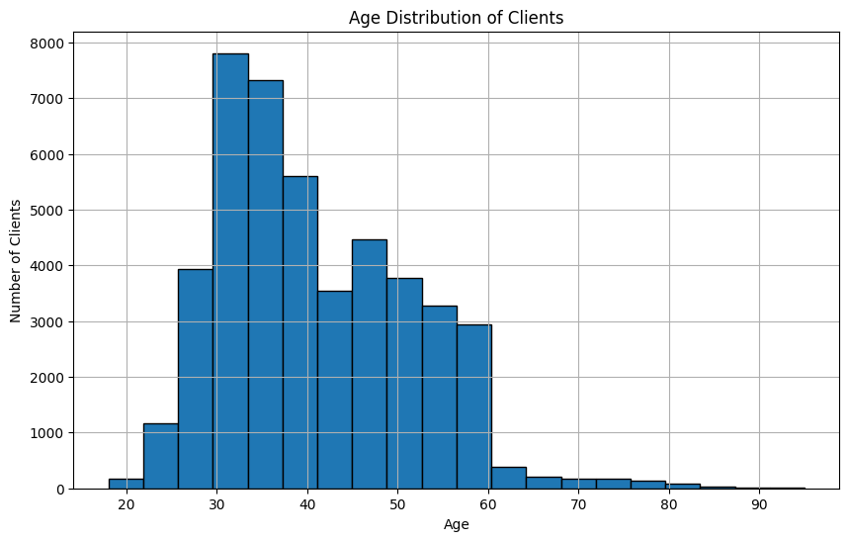
What is the distribution of age among the clients?

Slide 2
Age Distribution of Clients
Description:
A histogram of the age distribution of clients is plotted, with the x-axis representing age and the y-axis representing the number of clients.
Insights:
The age of clients ranges from 18 to 95 years.
The histogram likely shows a concentration of clients in specific age groups, which could indicate the bank's target demographic.

Slide 3
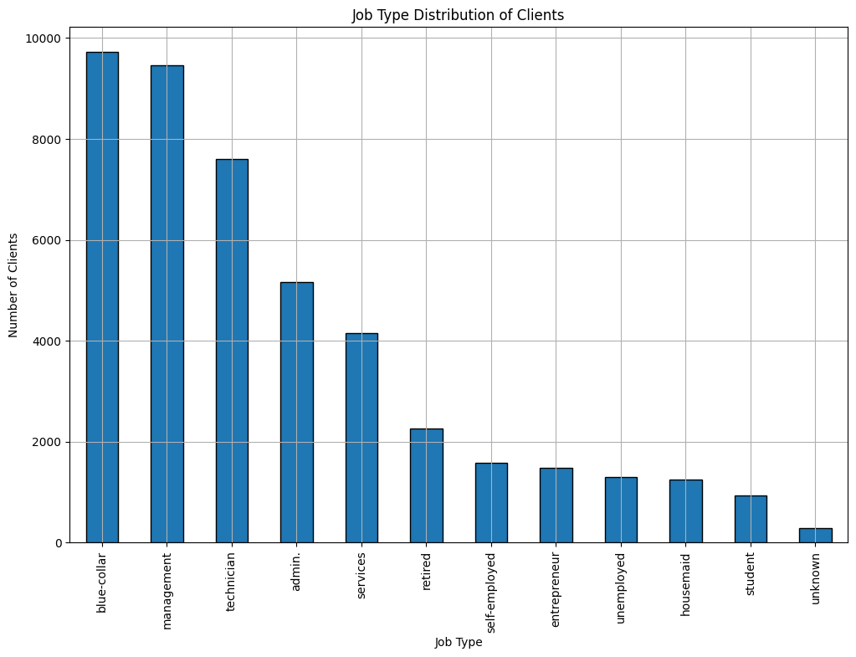
How does the job type vary among the clients?

Slide 4
Job Type Distribution of Clients
Description:
A bar chart displays the distribution of different job types among the clients. Each bar represents a job type, and the height of the bar represents the number of clients in that job type.
Insights:
The most common job types are 'blue-collar,' 'management,' and 'technician.'
Jobs such as 'student,' 'housemaid,' and 'unemployed' are less common among the clients.
This distribution could help the bank tailor its products and services to the most common professions.

Slide 5
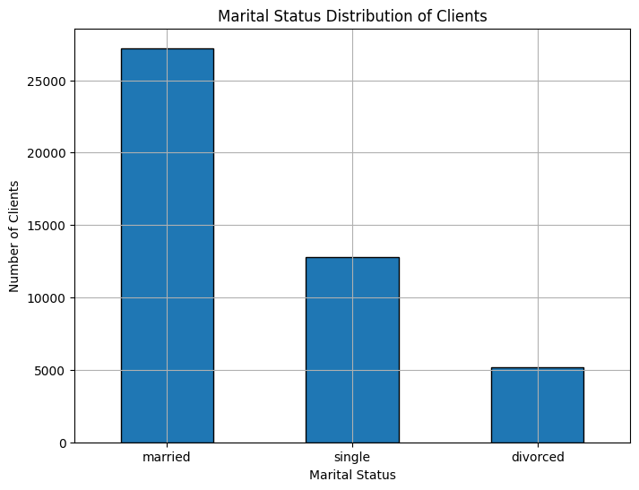
What is the marital status distribution of the clients?

Slide 6
Marital Status Distribution of Clients
Description:
A bar chart showing the distribution of marital status among clients. Each bar represents a marital status category (married, single, divorced).
Insights:
The majority of clients are married, followed by single, and then divorced.
Understanding the marital status distribution can help the bank in designing specific financial products that cater to different marital status groups.

Slide 7
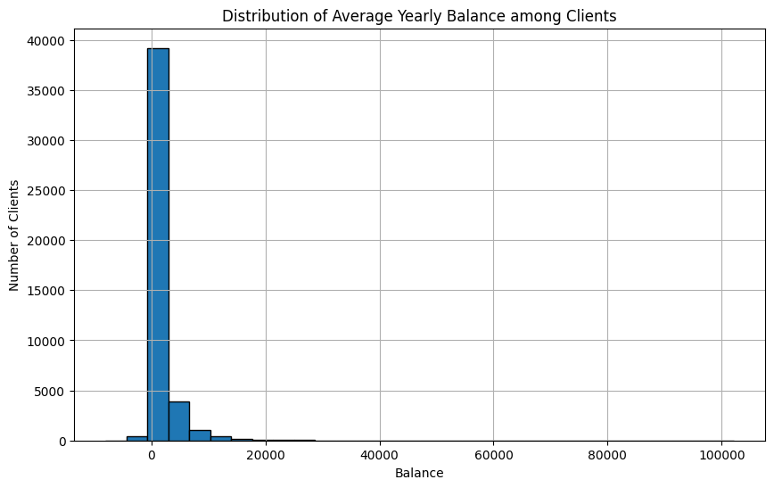
What is the distribution of average yearly balance among the clients?

Slide 8
Distribution of Average Yearly Balance among Clients
Description:
A histogram showing the distribution of average yearly balance among clients, with the x-axis representing balance amounts and the y-axis representing the number of clients.
Insights:
There is a wide range of balances, with many clients having lower balances and fewer clients having very high balances.
This distribution can help the bank understand the financial status of its clients and tailor services accordingly.

Slide 9
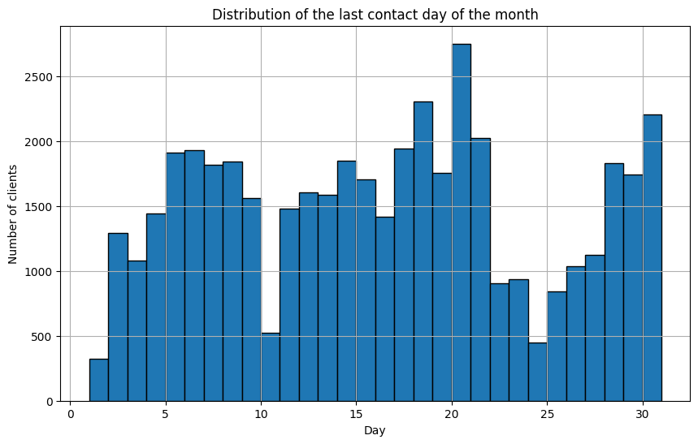
What is the distribution of the last contact day of the month?

Slide 10
Distribution of the Last Contact Day of the Month
Description:
A histogram showing the distribution of the last contact day of the month, with the x-axis representing the days and the y-axis representing the number of contacts.
Insights:
Certain days of the month (e.g., 20th, 18th, 21st) have higher contact frequencies.
This could help the bank optimize its contact strategy by focusing on the most effective days.

Slide 11
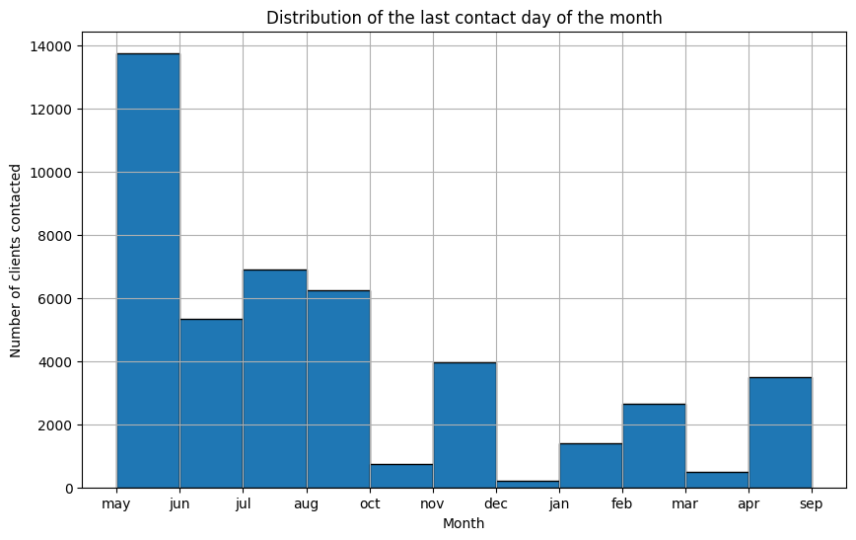
How does the last contact month vary among the clients?

Slide 12
Distribution of the Last Contact Month
Description:
A histogram or bar chart showing the distribution of the last contact month, with the x-axis representing months and the y-axis representing the number of contacts.
Insights:
May is the most common month for client contacts, followed by July and August.
This seasonal trend could inform the bank's marketing and outreach strategies.

Slide 13
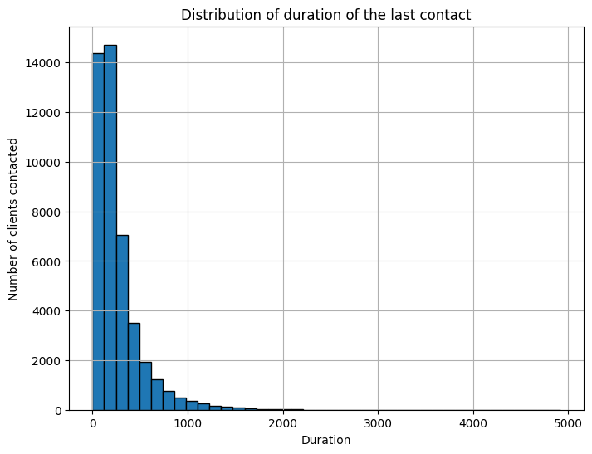
What is the distribution of the duration of the last contact?

Slide 14
Distribution of the Duration of the Last Contact
Description:
A histogram showing the distribution of the duration of the last contact, with the x-axis representing the duration in seconds and the y-axis representing the number of clients contacted.
Insights:
The duration of contacts varies, with most contacts lasting between 89 and 124 seconds.
Understanding contact duration can help improve the efficiency and effectiveness of communication with clients

Slide 15
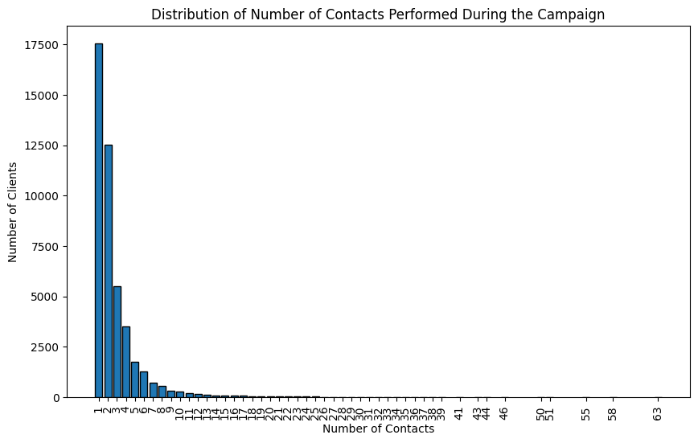
How many contacts were performed during the campaign for each client?

Slide 16
Number of Contacts Performed During the Campaign for Each Client
Description:
A histogram showing the number of contacts performed during the campaign for each client, with the x-axis representing the number of contacts and the y-axis representing the number of clients.
Insights:
The majority of clients were contacted between one and two times during the campaign, with a steep decline in the number of clients contacted more frequently. This suggests a campaign strategy focusing on initial outreach with limited follow-up for most clients.

Slide 17
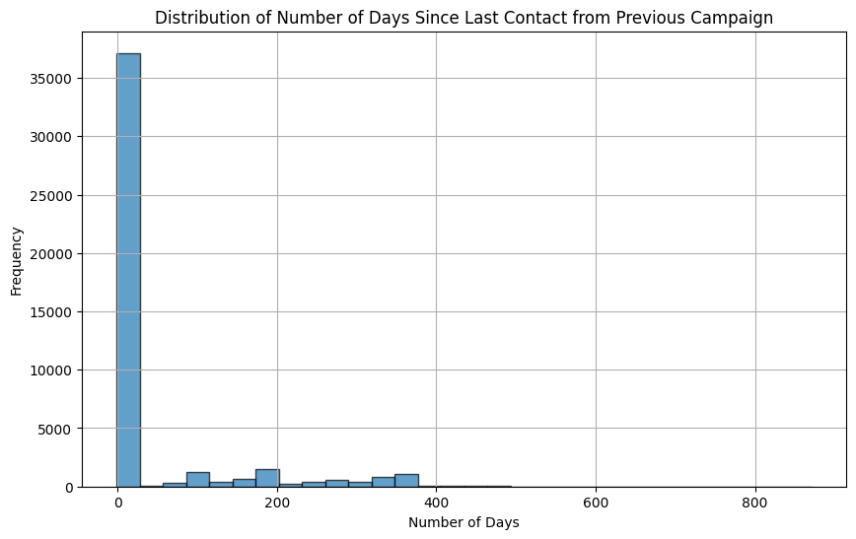
What is the distribution of the number of days passed since the client was last contacted from a previous campaign?

Slide 18
Distribution of the Number of Days Passed Since the Client Was Last Contacted from a Previous Campaign
Description:
A histogram showing the distribution of the number of days passed since the client was last contacted from a previous campaign, with the x-axis representing the number of days and the y-axis representing the number of clients.
Insights:
The distribution of the number of days since the last contact varies, with certain peaks indicating periods when a significant number of clients were last contacted. Understanding this distribution can help in planning follow-up strategies and identifying optimal re-engagement times.

Slide 19
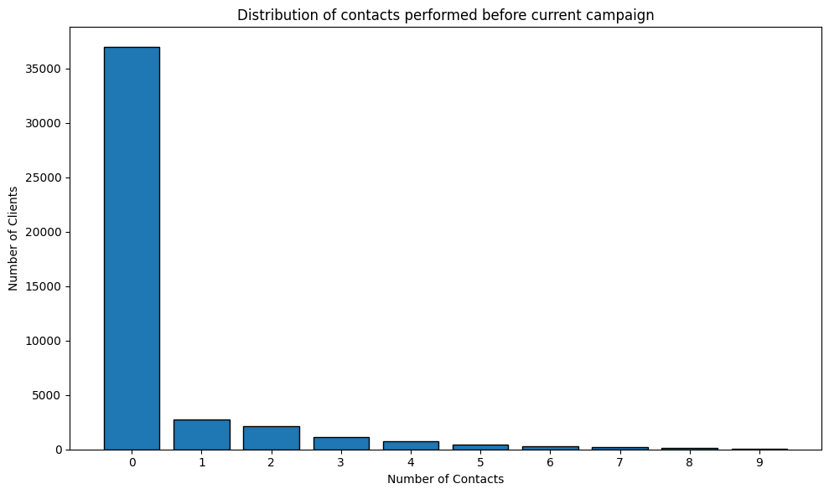
How many contacts were performed before the current campaign for each client?

Slide 20
Number of Contacts Performed Before the Current Campaign for Each Client
Description:
A histogram showing the number of contacts performed before the current campaign for each client, with the x-axis representing the number of contacts and the y-axis representing the number of clients.
Insights:
The majority of clients had very few contacts before the current campaign, with a notable number of clients having no prior contacts. This suggests that the campaign is engaging with a significant number of new or previously uncontacted clients, indicating potential growth in the client base or targeting new segments.

Slide 21
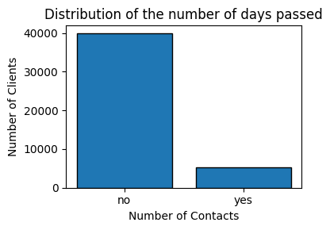
What is the distribution of clients who subscribed to a term deposit vs. those who did not?

Slide 22
Distribution of Clients Who Subscribed to a Term Deposit vs. Those Who Did Not
Description:
A bar chart showing the distribution of clients who subscribed to a term deposit (labeled as "yes") versus those who did not (labeled as "no"). The chart will help visualize the proportion of clients who were successfully converted during the campaign compared to those who were not.
Insights:
Understanding the distribution of term deposit subscriptions can provide valuable insights into the effectiveness of the campaign. A higher proportion of "yes" responses indicates successful campaign strategies, while a higher proportion of "no" responses might suggest the need for strategy adjustments

Slide 23
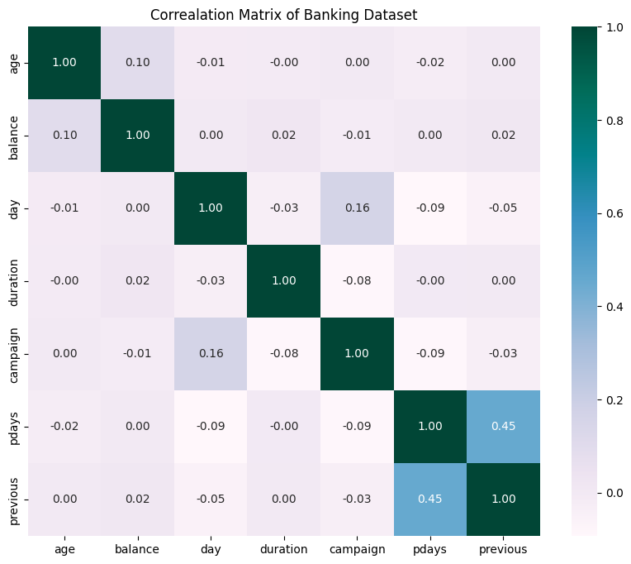
Are there any correlations between different attributes and the likelihood of subscribing to a term deposit?

Slide 24
The image you provided is a correlation matrix for a banking dataset. Correlation matrices are used to show the relationships between different variables in a dataset. Each cell in the matrix shows the correlation coefficient between two variables, ranging from -1 (perfect negative correlation) to +1 (perfect positive correlation).
Here is a brief interpretation of the matrix:
The diagonal values are all 1, which is expected because each variable is perfectly correlated with itself.
The age and balance have a slight positive correlation of 0.10.
The campaign and day have a slight positive correlation of 0.16.
The pdays and previous have a moderate positive correlation of 0.45.
None of the variables show a strong correlation (close to 1 or -1) with each other, indicating that they are relatively independent.

